Slide 1
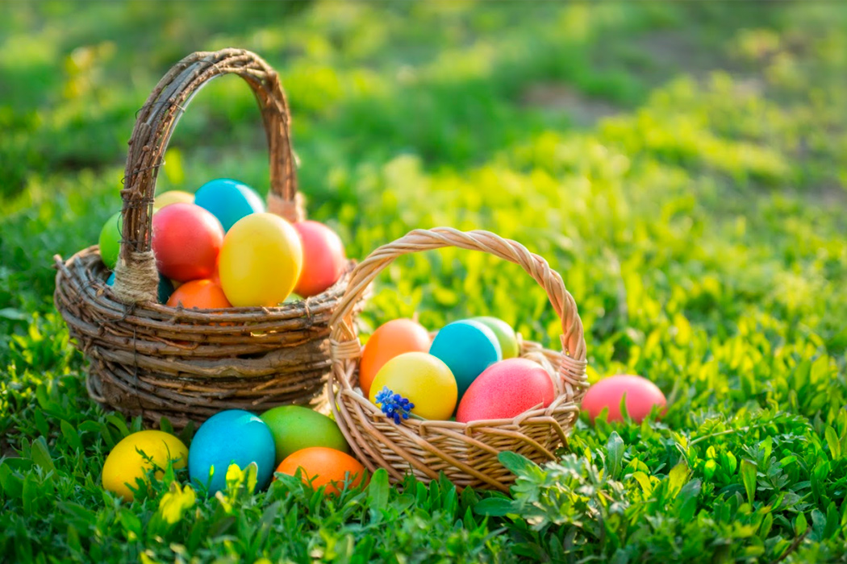
Easter in the UK!

Slide 2
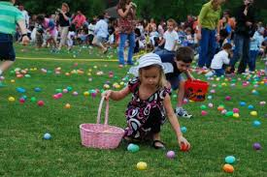
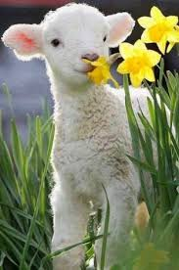
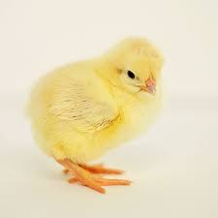
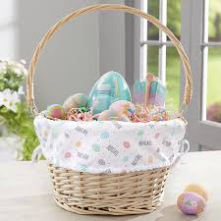
Haz clic en el ícono para escuchar la palabra
Easter egg
Easter Bunny
Easter egg hunt
Lamb
Chick
Easter basket

Slide 3
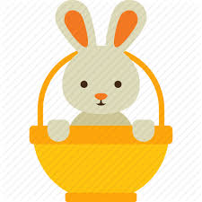
Easter egg hunt!
Find the Easter egg! Where is it hiding?
Haz clic en los íconos para encontrar el huevo
Good job! You found the egg!

Slide 4
Test!
Haz clic en los íconos para elegir la respuesta correcta
What season is Easter in?
Winter
Spring
Summer
Autumn

Slide 5
Test!
Which day of Easter is most important IN THE UK?
Friday
Saturday
Sunday
Monday

Slide 6
Test!
What do they eat at Easter IN THE UK?
Mona de pascua
Chocolate eggs
Biscuits
Carrots

Slide 7
Have a great Easter!
Listen to this Easter song and sing along!
https://www.youtube.com/watch?v=hb9tt7LiYrc

