Slide 1
MADE BY
Manuel Rodríguez, Talleb Bensad, Aron Deves and Juan Galindo.
TRABAJO REALIZADO POR: Manuel Rodríguez, Talleb, Aron Deves y Juan Galindo.

Slide 2
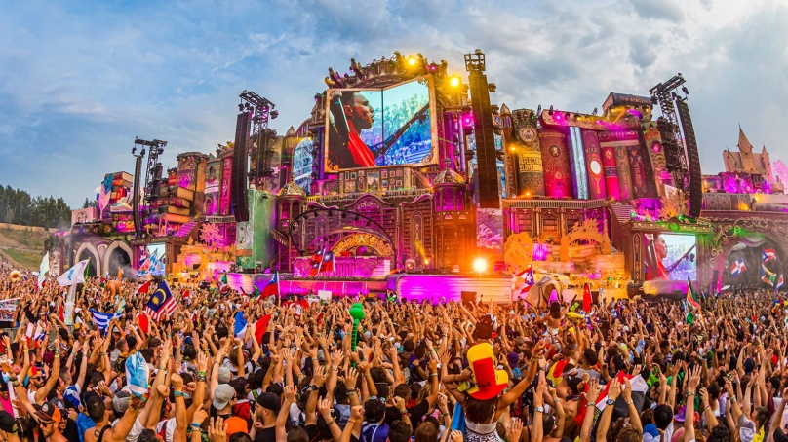
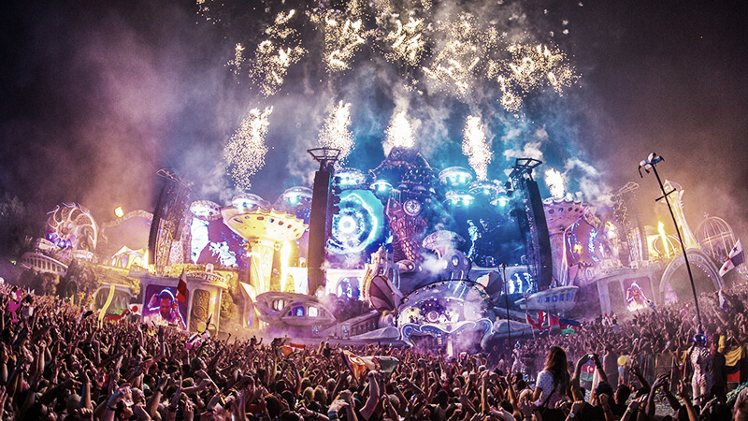
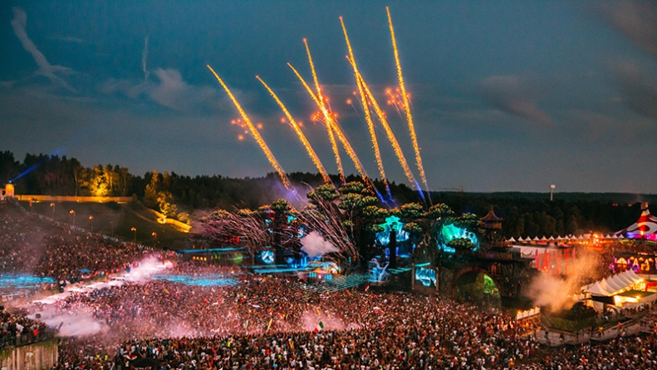
What is tomorrowland?
Tomorrowland is a Belgian electronic dance music festival held in Boom, Belgium.

Slide 3
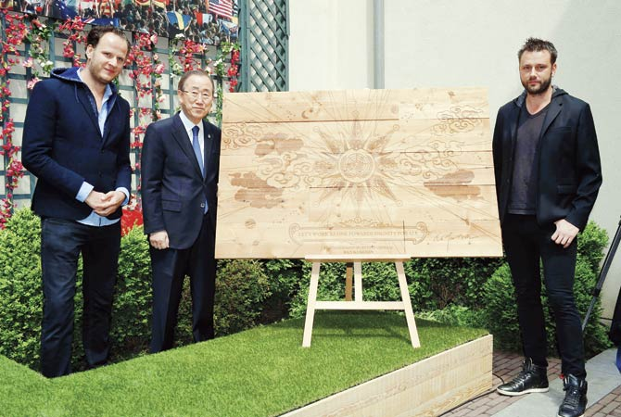
Which is its origin ?
The Brothers Manu and Michiel Beers began their dream and made it come true with Tomorrowland's debut.

Slide 4
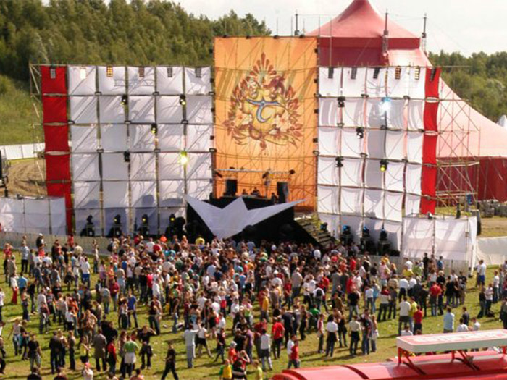
The first edition
The first edition of the festival took place on 14 August 2005. Manu Beers, Michiel Beers and ID&T organized the festival.

Slide 5
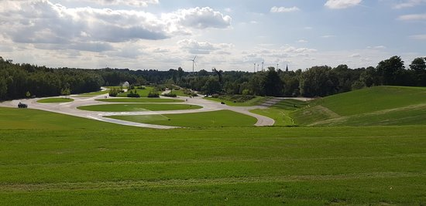
Where and when is it celebrated?
Tomorrowland takes place at recreation area De Schorre in Boom, Belgium. the date on which it is celebrated Friday July 17th 2020 - Sunday July 19th 2020 and Friday July 24th 2020 - Sunday July 26th 2020.

Slide 6
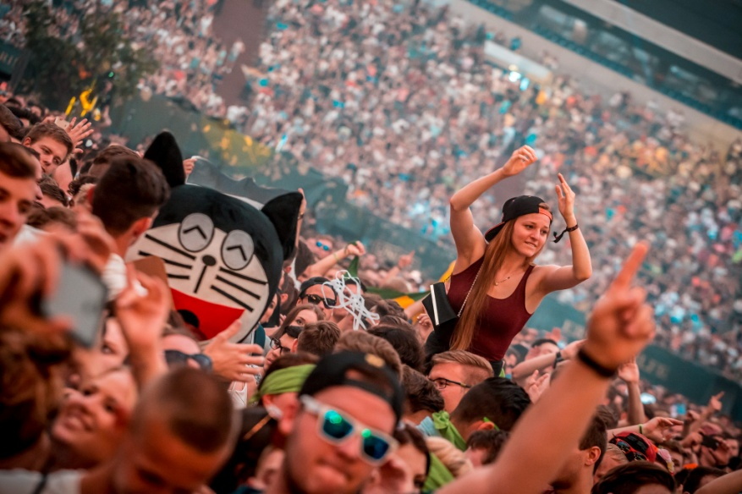
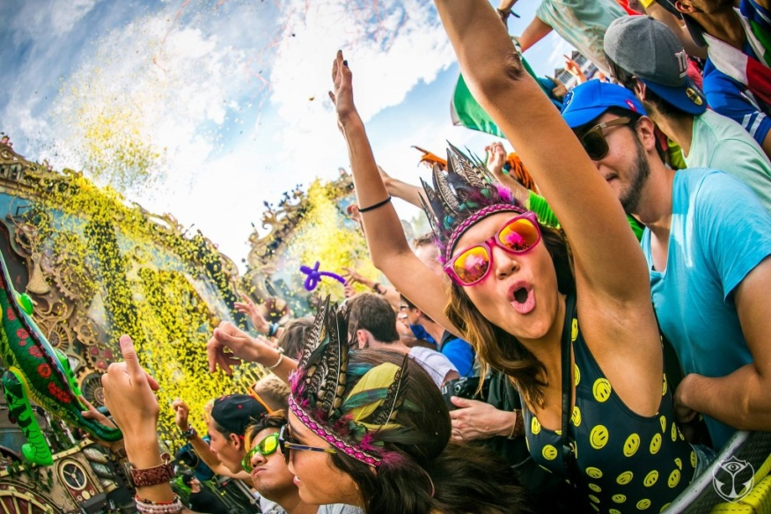
How is it celebrated?
This festival is celebrated by dancing and listening to music (Electronic) for three days in a row.

Slide 7
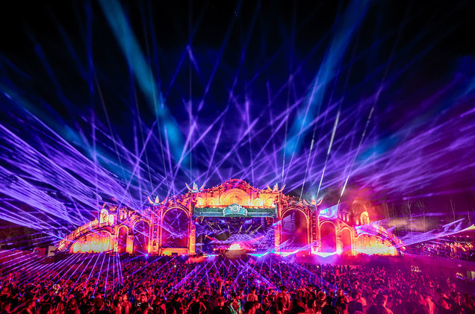
Why have you chosen that festival?
We have chosen this festival because we all like electronic music.

Slide 8
BIBLIOGRAPHY
https://mdmelectro.com/cosas-sabias-tomorrowland/
https://en.wikipedia.org/wiki/Tomorrowland_(festival)
https://dbr.fm/biografias/tomorrowland-la-magnifica-historia-detras-del-festival-mas-popular-del-mundo/
https://www.tomorrowland.com/global/

