Slide 1
The National Prides in European Context
Latvia

Slide 2
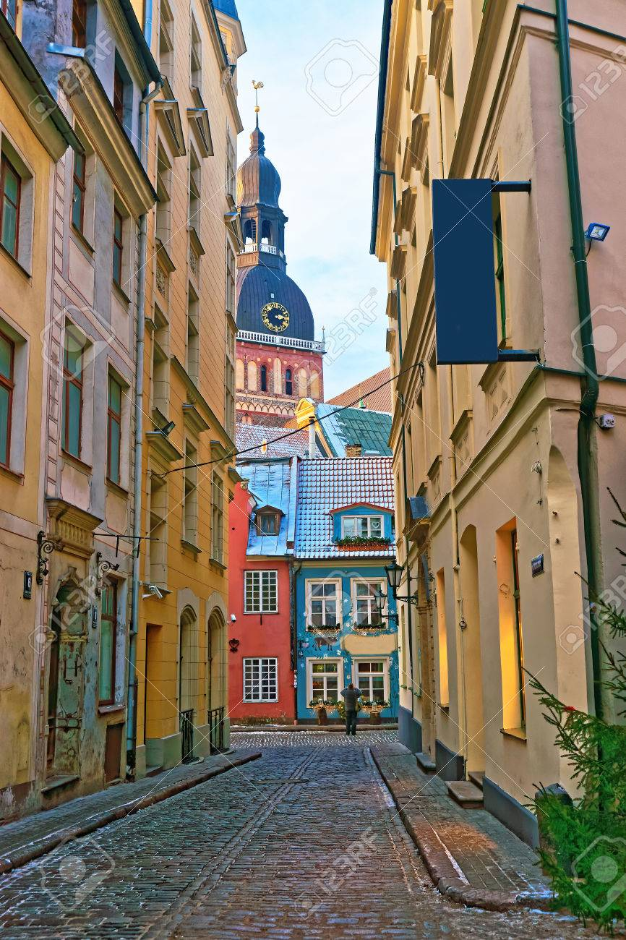
Old Town Riga
The UNESCO World heritage site - Historic Centre of Riga - Old Town Riga is a popular tourism district in the historical and geographical center of the Latvian capital
cobble-stone streets, Medieval-era buildings, unique sacral structures and an abundance of architectural gems.

Slide 3
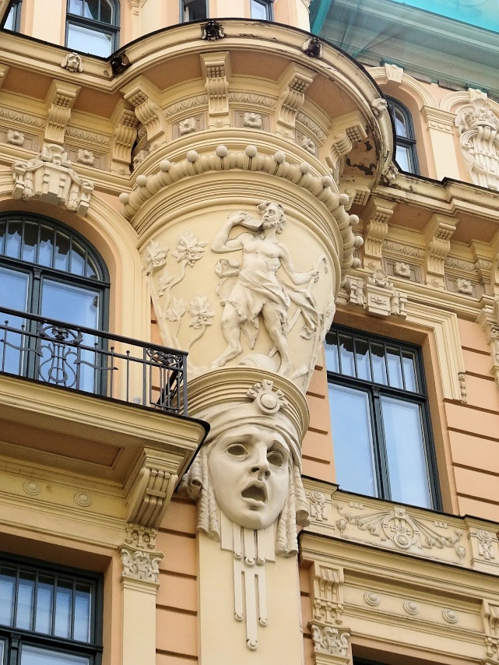
It is generally recognized that Riga has the finest collection of art nouveau buildings in Europe.

Slide 4
The Song and Dance Celebrations
The Latvian Song and Dance Celebrations is the most magnificent event in the Latvian cultural life, attracting thousands of viewers and listeners every five years, one week.
The song and dance festival, which includes choirs and dance groups from all over Latvia, is included in the UNESCO World Heritage List of Oral and Intangible Cultural Heritage.
Since 1873, this festival has taken place 26 times.
video

Slide 5
Baltic Way
The Baltic Way – the Human Chain linking three Baltic capital cities (Tallinn, Riga, Vilnius) was a campaign held on August 23, 1989 at 19.00, when about 2 million people held their hands for 15 minutes.
The length of the chain was 600 km.
This demonstration was organized to draw the world's attention to the Baltic states drive for freedom.

Slide 6
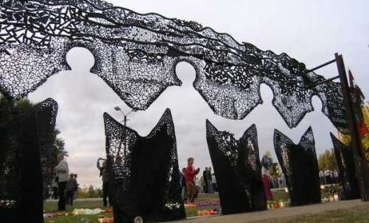
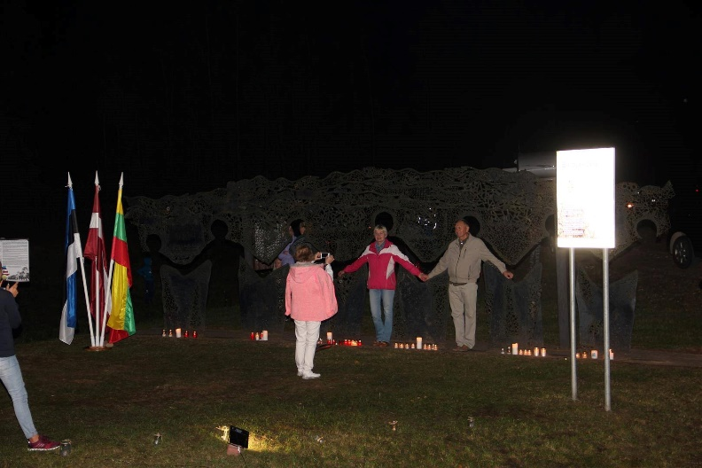
The monument to the Baltic Way on the Latvian-Estonian border

Slide 7
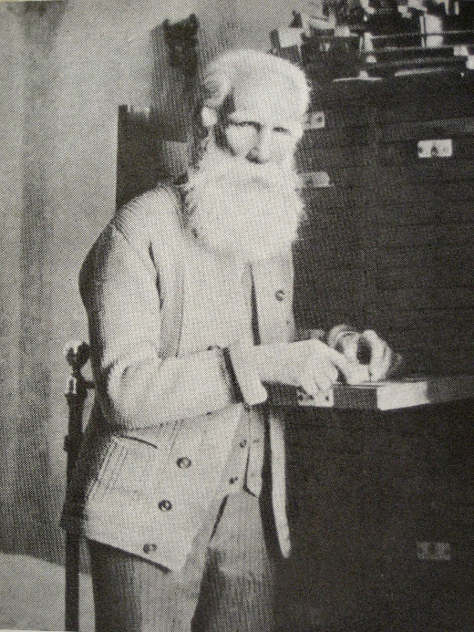
The Cabinet of Folksongs
The UNESCO World memory site - The Cabinet of Folksongs/ Dainu skapis - a cabinet with 73 drawers used as an editor's tool by Krišjānis Barons (1835-1923) working at the most famous edition of Latvian folksongs “Latvju Dainas” (published in 6 volumes / 8 tomes between 1894 and 1915).
Documentary heritage included in the UNESCO Memory of the World Register in 2001.

Slide 8
The source material for each of the printed songs, sent in to Barons by thousands of singers and informants, consists of over 350,000 hand-written paper slips sized 3 x 11 cm in many handwritings.

Slide 9
The Suiti cultural space
The Suiti cultural space is a unique phenomenon in Latvian culture. The Suiti are a small Catholic community in the Protestant (Lutheran) western part of Latvia.
The Suiti cultural space is characterized by a number of distinct features, including vocal drone singing performed by Suiti women, wedding traditions, colorful traditional costumes, the Suiti language, local cuisine, religious traditions, celebrations of seasonal traditions, and a remarkable number of folksongs, dances and melodies recorded in this community.
October 1, 2009 Suiti cultural space was included in the UNESCO List of Intangible Cultural Heritage in Need of Urgent Safeguarding.

Slide 10
Websites
http://latvijasdargumi.unesco.lv/en/detailed-information/internationally-recognised-objects/

