Slide 1





Slide 2






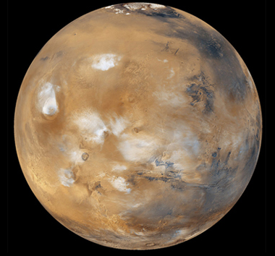

NEXT
Photo courtesy of USDAgov (@flickr.com) - granted under creative commons licence - attribution

Slide 3



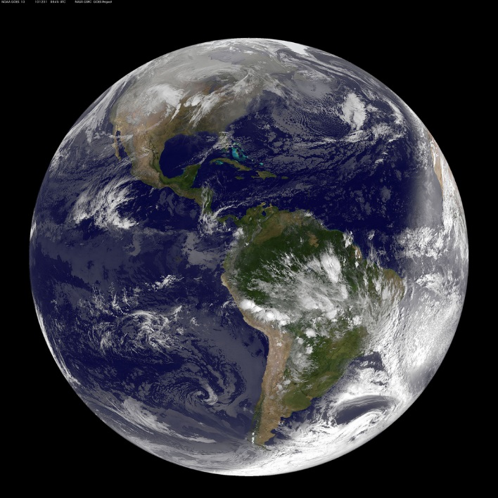

NEXT
Photo courtesy of NASA Goddard Photo and Video (@flickr.com) - granted under creative commons licence - attribution

Slide 4

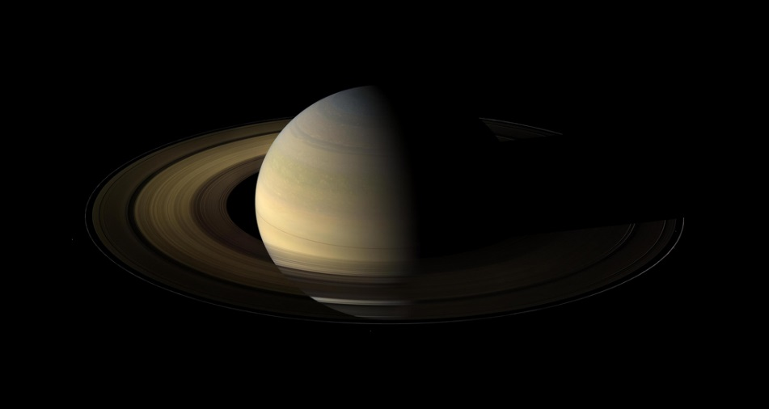

NEXT
Photo courtesy of NASA Goddard Photo and Video (@flickr.com) - granted under creative commons licence - attribution

Slide 5


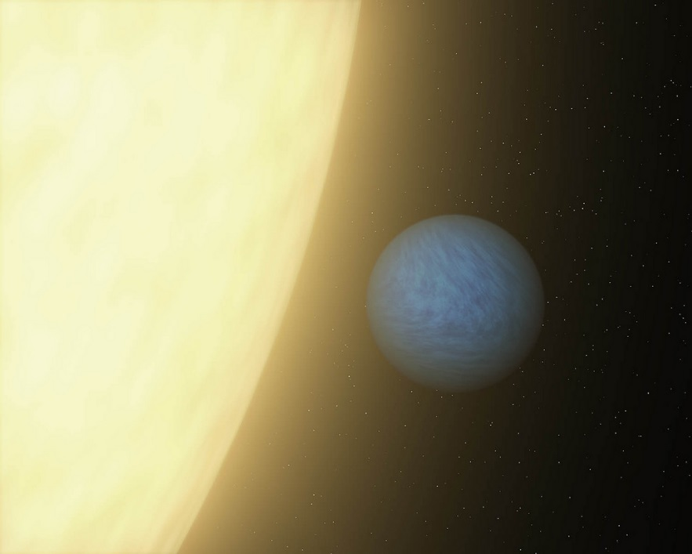

NEXT
Photo courtesy of NASAblueshift (@flickr.com) - granted under creative commons licence - attribution

Slide 6
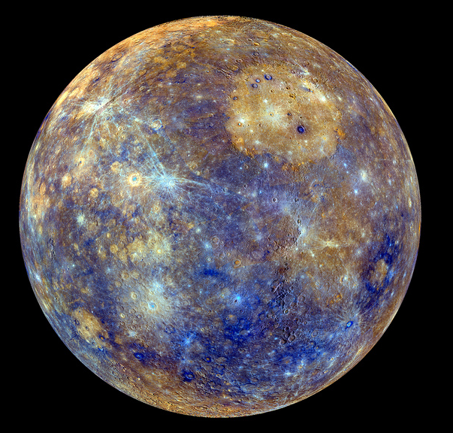

NEXT
Photo courtesy of NASA Goddard Photo and Video (@flickr.com) - granted under creative commons licence - attribution

Slide 7


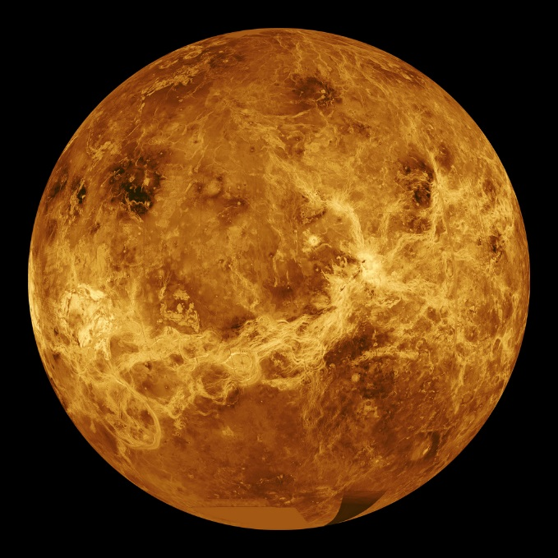

NEXT
Photo courtesy of NASA Goddard Photo and Video (@flickr.com) - granted under creative commons licence - attribution

Slide 8



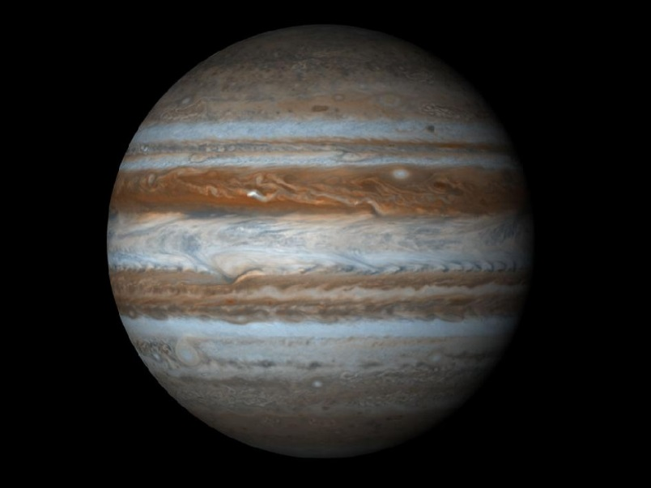

NEXT
Photo courtesy of NASA Goddard Space Flight Center (@flickr.com) - granted under creative commons licence - attribution

Slide 9
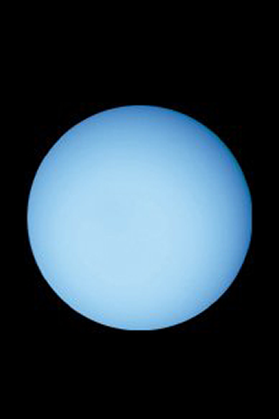

NEXT
Photo courtesy of chrismeller (@flickr.com) - granted under creative commons licence - attribution

Slide 10

THE END

